Slide 1
Statistics
Parameswari Ettiappan

Slide 2
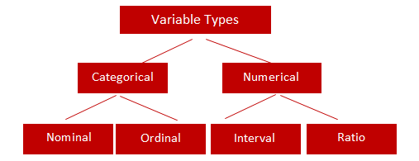
Types of Variables

Slide 3
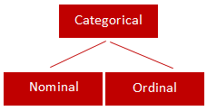
Categorical
Qualitative data are often termed categorical data.
Data that can be added into categories according to their characteristics.
Examples are gender, social class and blood types

Slide 4
Nominal Variable (Unordered list)
A variable that has two or more categories, without any implied ordering.
Examples : Gender - Male, Female
Marital Status - Unmarried, Married, Divorcee
State - New Delhi, Haryana, Illinois, Michigan

Slide 5
Ordinal Variable (Ordered list)
A variable that has two or more categories, with clear ordering. Examples :
Scale - Strongly Disagree, Disagree, Neutral, Agree, Strongly Agree
Rating - Very low, Low, Medium, Great, Very great

Slide 6
Interval
An interval variable is similar to an ordinal variable, except that the intervals between the values of the interval variable are equally spaced.
In other words, it has order and equal intervals.
Examples :
Temperature in Celsius - Temperature of 30°C is higher than 20°C, and temperature of 20°C is higher than 10°C. The size of these intervals is the same.
Annual Income in Dollars - Three people who make $5,000, $10,000 and $15,000. The second person makes $5,000 more than the first person and $5,000 less than the third person, and the size of these intervals is the same.

Slide 7
Ratio
It is interval data with a natural zero point.
When the variable equals 0.0, there is none of that variable. Examples :
Height
Weight
Temperature in Kelvin - It is a ratio variable, as 0.0 Kelvin really does mean 'no temperature.

Slide 8
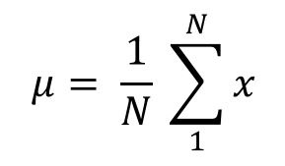
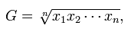
Central Location
(a) Arithmetic Mean
Of these “averages,” the most common and familiar is the arithmetic mean, defined by
(b) Geometric Mean
The geometric mean is defined as the nth root of the product of n observations:

Slide 9
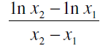
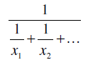
Central Location
© Logarithmic Mean
The logarithmic mean of two numbers is given by the difference of the natural logarithms of the two numbers, divided by the difference between the numbers.
It is used particularly in heat transfer and mass transfer.
(d) Harmonic Mean
The harmonic mean involves inverses—i.e., one divided by each of the quantities.
The harmonic mean is the inverse of the arithmetic mean of all the inverses.

Slide 10
Median
If all the items with which we are concerned are sorted in order of increasing magnitude (size), from the smallest to the largest, then the median is the middle item.
Consider the five items: 12, 13, 21, 27, 31. Then 21 is the median.
If the number of items is even, the median is given by the arithmetic mean of the two middle items. Consider the six items: 12, 13, 21, 27, 31, 33.
The median is (21 + 27) / 2 = 24.

Slide 11
Mode
If the frequency varies from one item to another, the mode is the value which appears most frequently.
In the case of continuous variables the frequency depends upon how many digits are quoted, so the mode is more usefully considered as the midpoint of the class with the largest frequency.

Slide 12
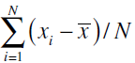
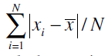
Variability or Spread of the Data
Mean Deviation from the Mean
The mean deviation from the mean, defined as –
Mean Absolute Deviation from the Mean

Slide 13
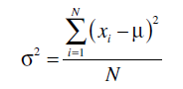
Variability or Spread of the Data
Variance
Since squares of both positive and negative real numbers are always positive, the variance is always positive.

Slide 14
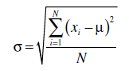
Variability or Spread of the Data
Standard Deviation

Slide 15
Quartiles, Deciles, Percentiles, and Quantiles
Quartiles, deciles, and percentiles divide a frequency distribution into a number of parts containing equal frequencies.
Quartiles divide the range of values into four parts, each containing one quarter of the values.
Percentiles divide into a hundred parts, each containing one hundredth of the total frequency.
Quantile divides a frequency distribution into parts containing stated proportions of a distribution.

Slide 16
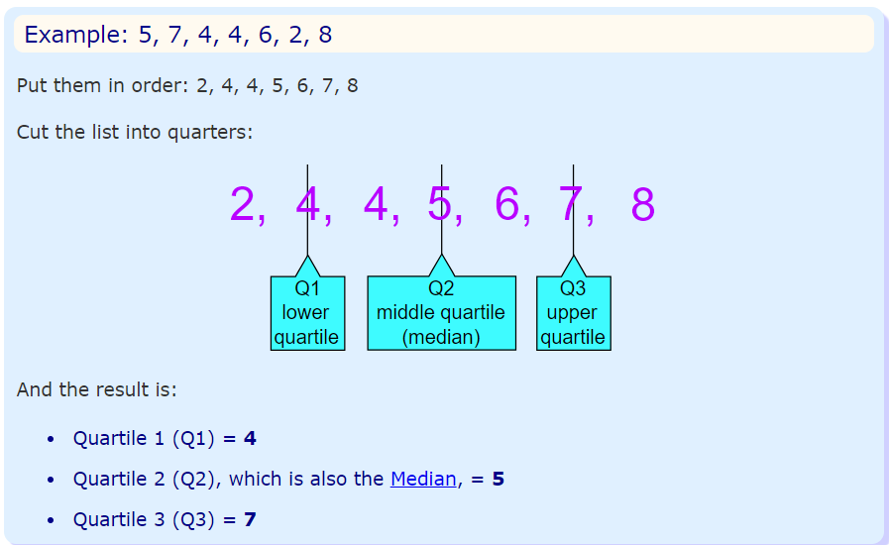
Quartiles
Quartiles are the values that divide a list of numbers into quarters:
Put the list of numbers in order
Then cut the list into four equal parts
The Quartiles are at the "cuts“

Slide 17
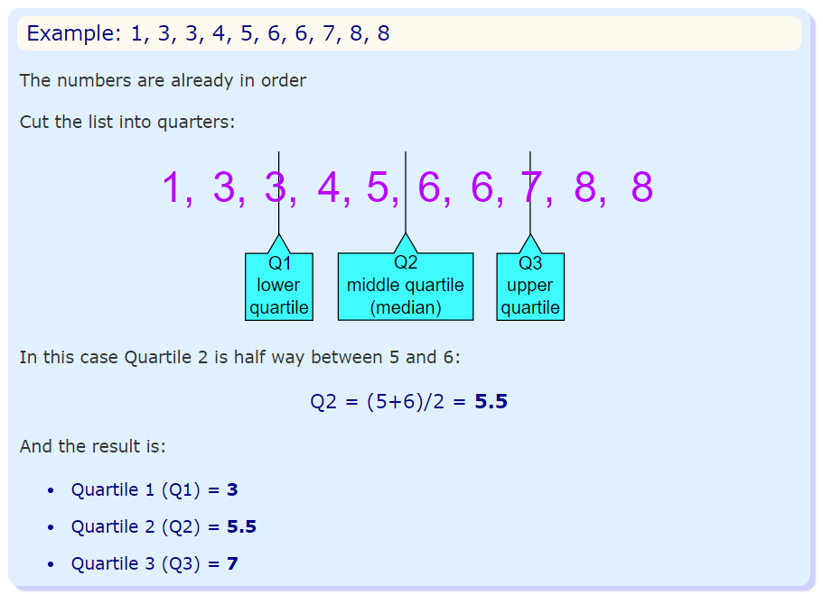
Quartiles

Slide 18
Normal Distribution
A normal distribution, sometimes called the bell curve, is a distribution that occurs naturally in many situations.
For example, the bell curve is seen in tests like the SAT and GRE.
The bulk of students will score the average (C), while smaller numbers of students will score a B or D.
An even smaller percentage of students score an F or an A.
This creates a distribution that resembles a bell (hence the nickname).
The bell curve is symmetrical. Half of the data will fall to the left of the mean; half will fall to the right.

Slide 19
Normal Distribution
Many groups follow this type of pattern. That’s why it’s widely used in business, statistics and in government bodies like the FDA:
Heights of people.
Measurement errors.
Blood pressure.
Points on a test.
IQ scores.
Salaries.

Slide 20
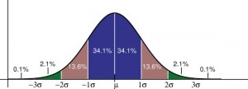
Normal Distribution
The empirical rule tells you what percentage of your data falls within a certain number of standard deviations from the mean: • 68% of the data falls within one standard deviation of the mean. • 95% of the data falls within two standard deviations of the mean. • 99.7% of the data falls within three standard deviations of the mean.

Slide 21
Normal Distribution
The standard deviation controls the spread of the distribution.
A smaller standard deviation indicates that the data is tightly clustered around the mean; the normal distribution will be taller.
A larger standard deviation indicates that the data is spread out around the mean; the normal distribution will be flatter and wider.

Slide 22
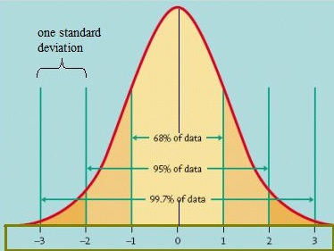
Standard Normal Model

Slide 23
Normal Distribution
Properties of a normal distribution
The mean, mode and median are all equal.
The curve is symmetric at the center (i.e. around the mean, μ).
Exactly half of the values are to the left of center and exactly half the values are to the right.
The total area under the curve is 1.

Slide 24
Word problems with normal distribution: “Between”: Steps
Step 1: Identify the parts of the word problem. The word problem will identify:
The mean (average or μ).
Standard deviation (σ).
Number selected (i.e. “choose one at random” or “select ten at random”).
X: the numbers associated with “between” (i.e. “between $5,000 and $10,000” would have X as 5,000 and as $10,000).

Slide 25
Word problems with normal distribution: “Between”: Steps
Step 1: Identify the parts of the word problem. The word problem will identify:
The mean (average or μ).
Standard deviation (σ).
Number selected (i.e. “choose one at random” or “select ten at random”).
X: the numbers associated with “between” (i.e. “between $5,000 and $10,000” would have X as 5,000 and as $10,000).

Slide 26
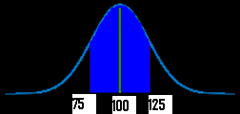
Word problems with normal distribution: “Between”: Steps
Step 2: Draw a graph. Put the mean you identified in Step 1 in the center.
Put the number associated with “between” on the graph (take a guess at where the numbers would fall–it doesn’t have to be exact).
For example, if your mean was $100, and you were asked for “hourly wages between $75 and $125”) your graph will look something like this:

Slide 27
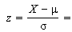
Word problems with normal distribution: “Between”: Steps
Step 3:Figure out the z-scores.
Plug the first X value (in my graph above, it’s 75) into the z value formula and solve. The μ (the mean), is 100 from the sample graph. You can get these figures (including σ, the standard deviation) from your answers in step 1 :
z score formula
*Note: if the formula confuses you, all this formula is asking you to do is:
subtract the mean from X
divide by the standard deviation.

Slide 28
Word problems with normal distribution: “Between”: Steps
Step 4: Repeat step 3 for the second X.
Step 5: Take the numbers from step 3 and 4 and use them to find the area in the z-table.
Step 6a:
Convert the answer from step 5 into a percentage.
For example, 0.1293 is 12.93%.
That’s it–skip step 6b!
Step 6b
Multiply the sample size (found in step 1) by the z-value you found in step 4. For example, 0.300 * 100 = 30.
That’s it!

Slide 29
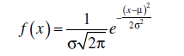
Normal Distribution
They are approximately symmetrical, and the mode is close to the centre of the distribution.
The mean, median, and mode are close together.
The shape of the distribution can be approximated by a bell: nearly flat on top, then decreasing more quickly, then decreasing more slowly toward the tails of the distribution.
This implies that values close to the mean are relatively frequent, and values farther from the mean tend to occur less frequently.
Probability Density Function

Slide 30
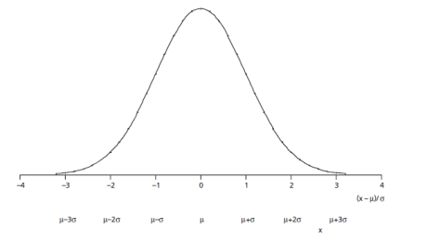
Normal Distribution

Slide 31
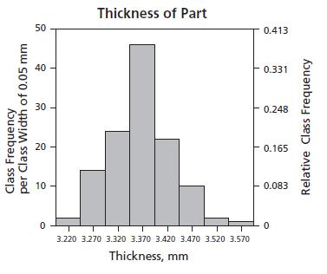
Normal Distribution

Slide 32

Feature Scaling
StandardScaler
MinMaxScaler
RobustScaler
Normalizer

Slide 33
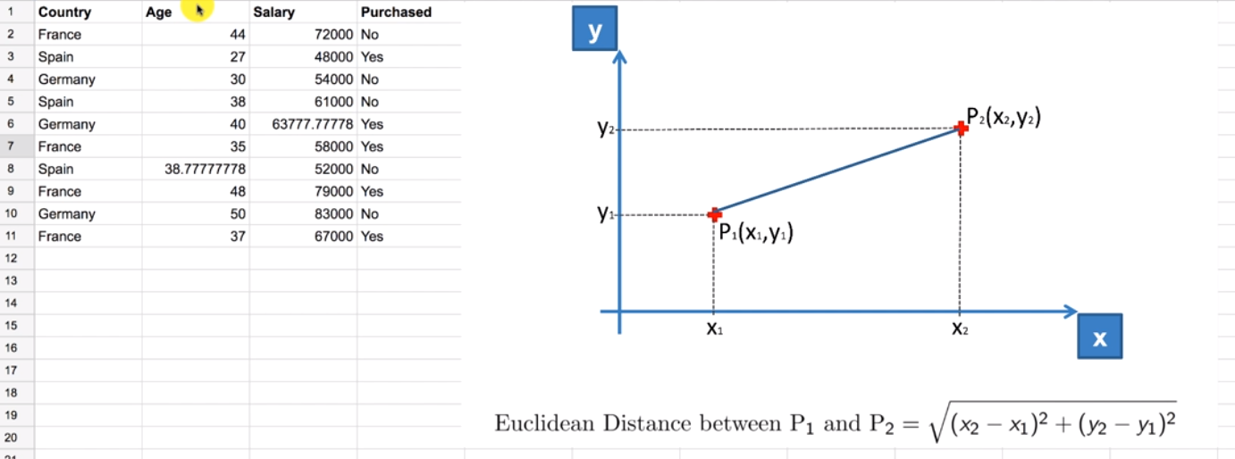

Slide 34
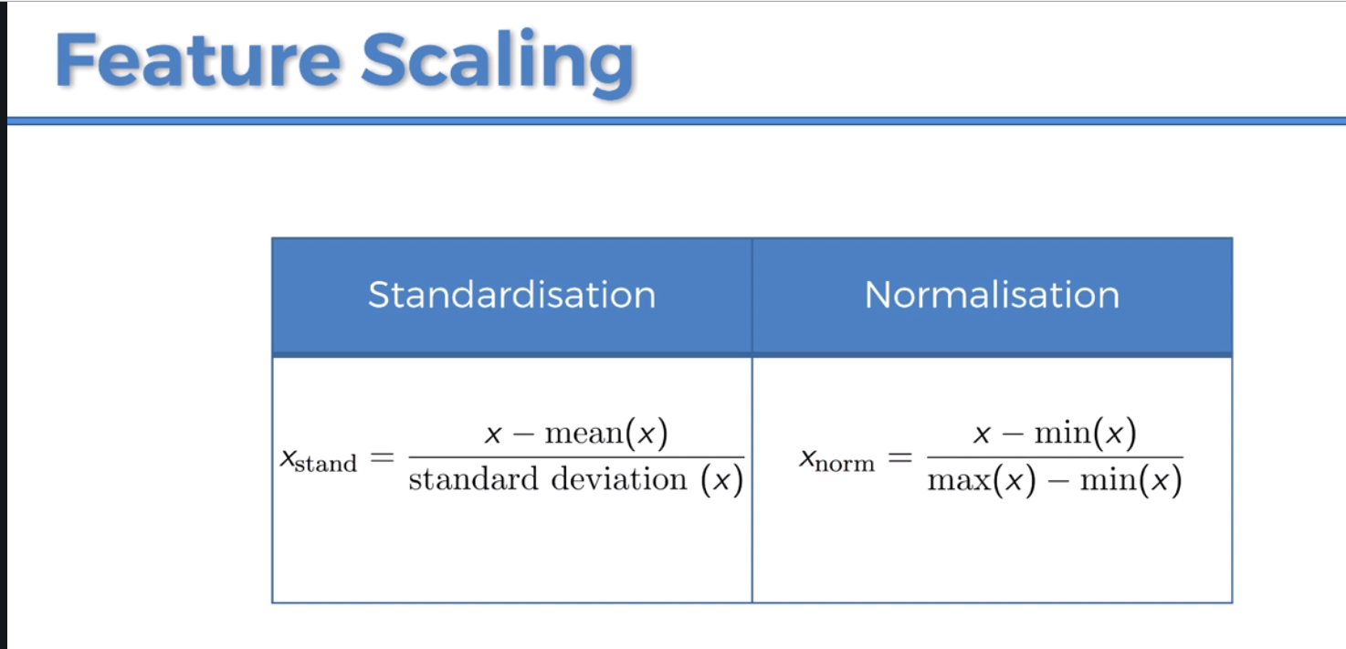

Slide 35
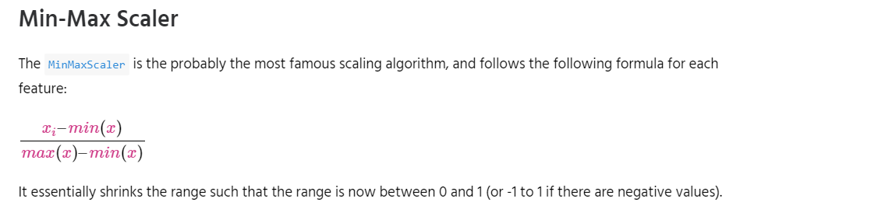
Feature Scaling
StandardScaler
MinMaxScaler
RobustScaler
Normalizer

Slide 36
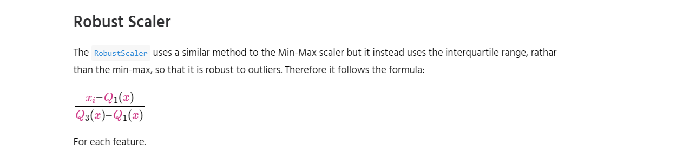
Feature Scaling

Slide 37
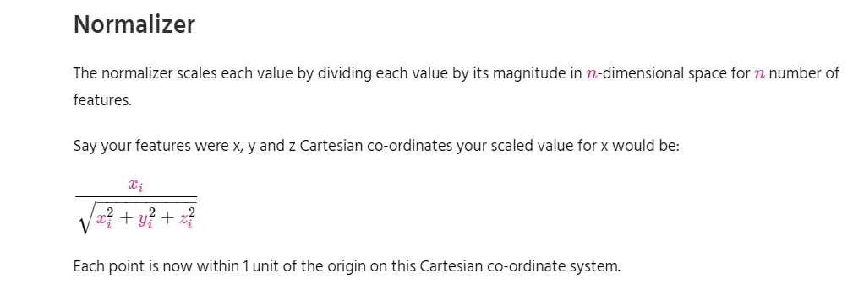
Feature Scaling

Slide 38
Simple Linear Regression
Simple linear regression is a statistical method that allows us to summarize and study relationships between two continuous (quantitative) variables:
One variable, denoted x, is regarded as the predictor, explanatory, or independent variable.
The other variable, denoted y, is regarded as the response, outcome, or dependent variable.

Slide 39
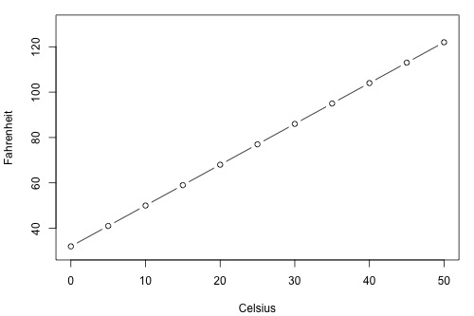
Simple Linear Regression

Slide 40
Types of Relationships
Deterministic
Temperature conversion
Circumference = π × diameter
Hooke's Law: Y = α + βX, where Y = amount of stretch in a spring, and X = applied weight.
Ohm's Law: I = V/r, where V = voltage applied, r = resistance, and I = current.
Boyle's Law: For a constant temperature, P = α/V, where P = pressure, α = constant for each gas, and V = volume of gas.

Slide 41
Types of Relationships
Statistical
Height and weight — as height increases, you'd expect weight to increase, but not perfectly.
Alcohol consumed and blood alcohol content — as alcohol consumption increases, you'd expect one's blood alcohol content to increase, but not perfectly.
Vital lung capacity and pack-years of smoking — as amount of smoking increases (as quantified by the number of pack-years of smoking), you'd expect lung function (as quantified by vital lung capacity) to decrease, but not perfectly.
Driving speed and gas mileage — as driving speed increases, you'd expect gas mileage to decrease, but not perfectly.

Slide 42
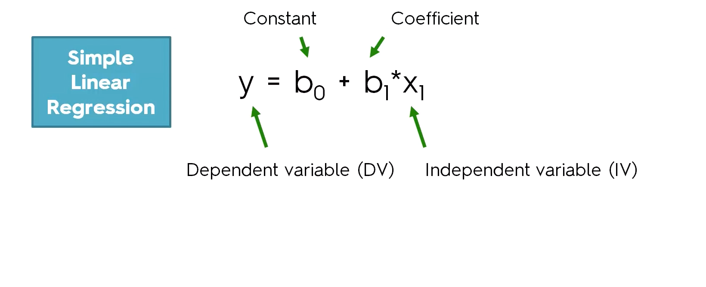

Slide 43
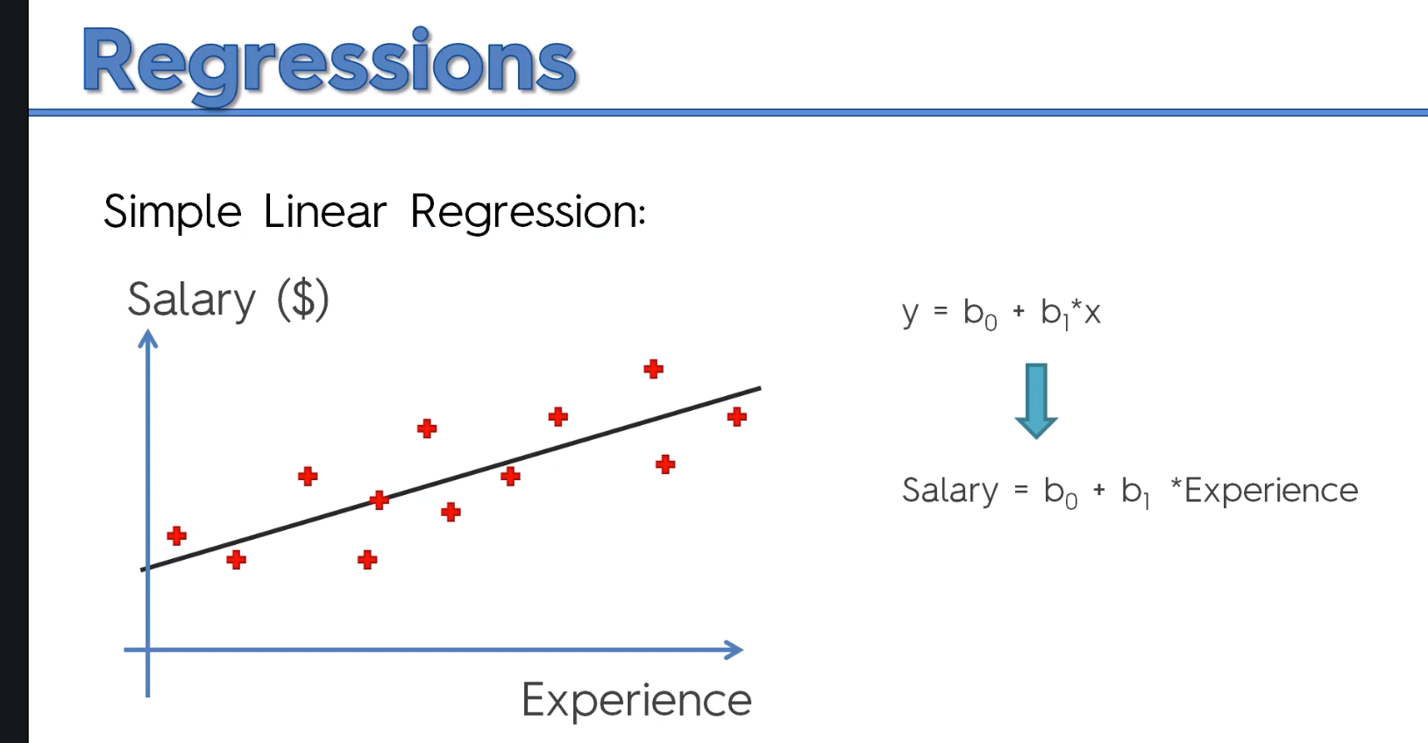

Slide 44
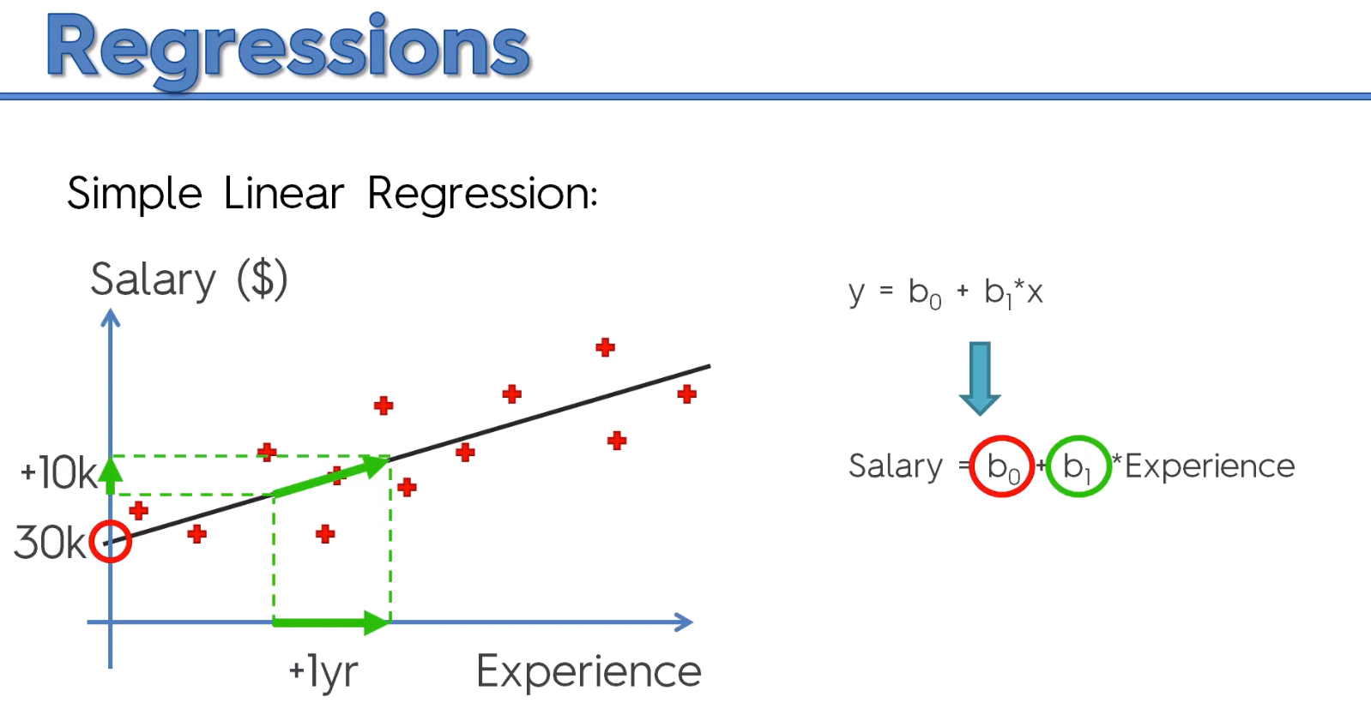

Slide 45
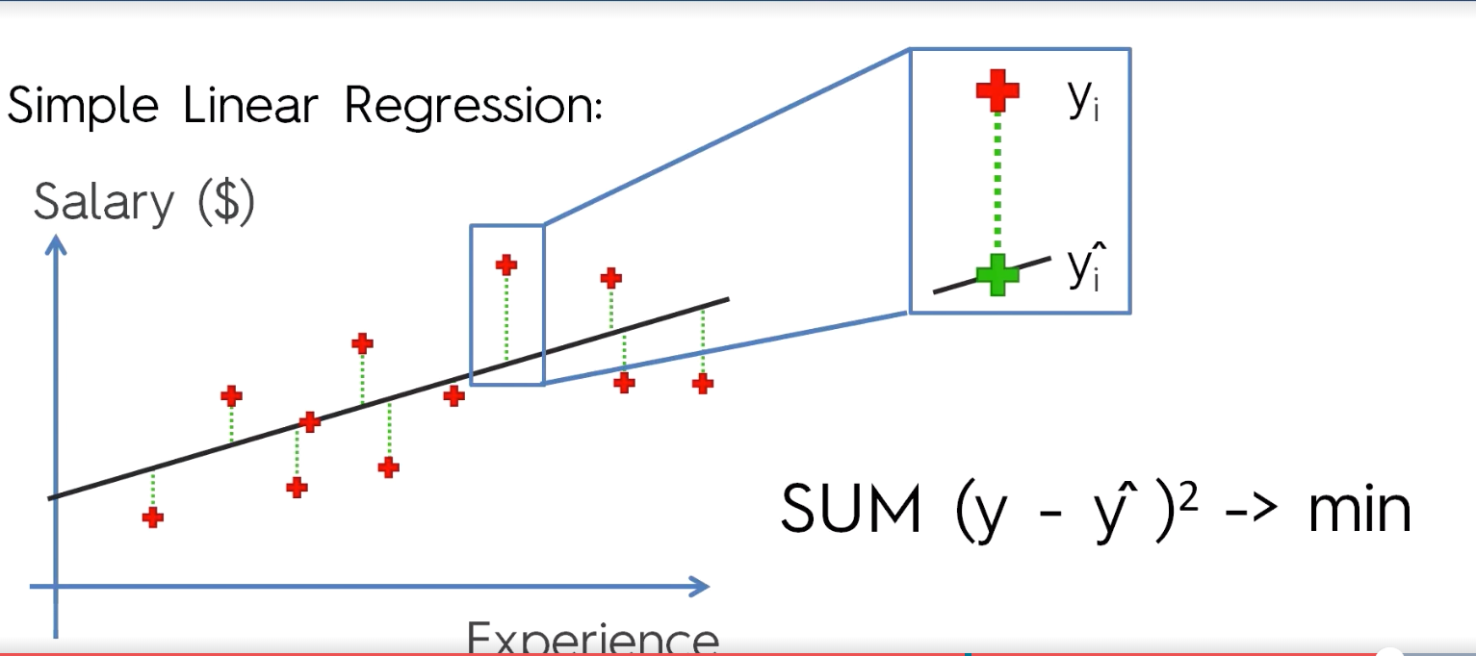
Ordinary Least Square Method

Slide 46
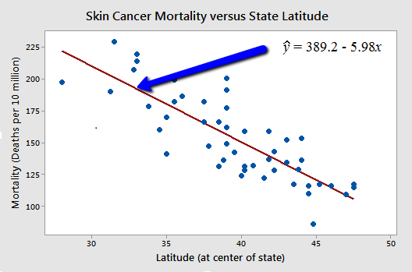
Types of Relationships

Slide 47
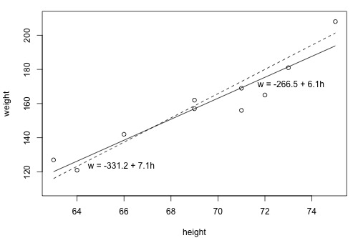
What is the "Best Fitting Line"?

Slide 48
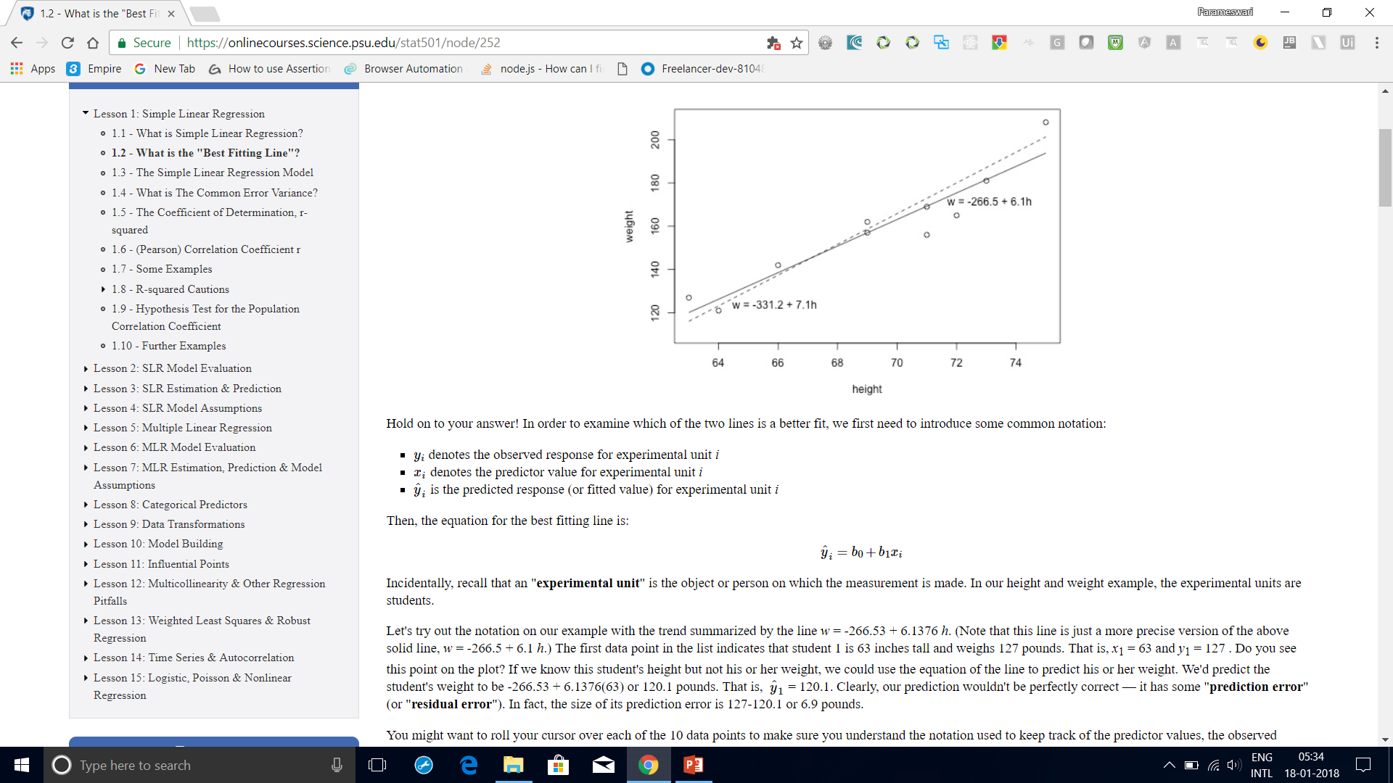
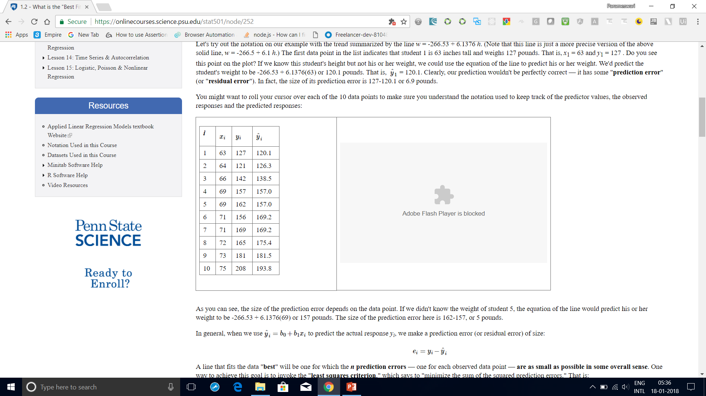
What is the "Best Fitting Line"?
it has some "prediction error" (or "residual error").
In fact, the size of its prediction error is 127-120.1 or 6.9 pounds.
As you can see, the size of the prediction error depends on the data point.
If we didn't know the weight of student 5, the equation of the line would predict his or
her weight to be -266.53 + 6.1376(69) or 157 pounds.
The size of the prediction error here is 162-157, or 5 pounds.

Slide 49
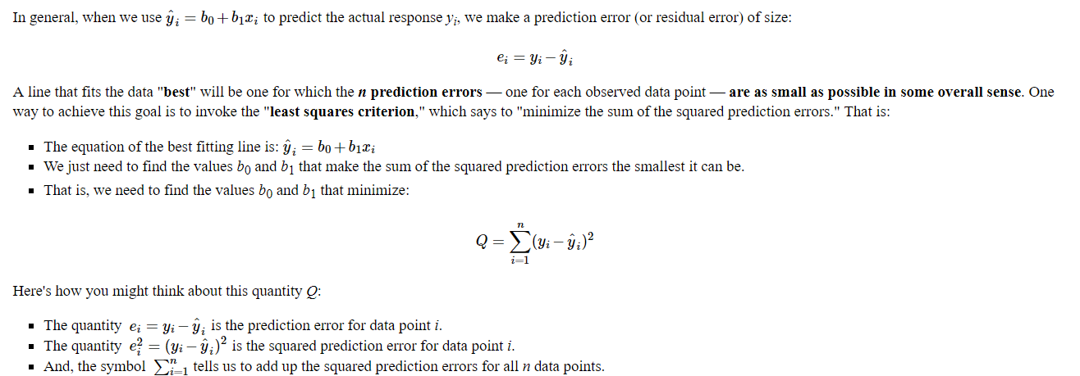
What is the "Best Fitting Line"?

Slide 50
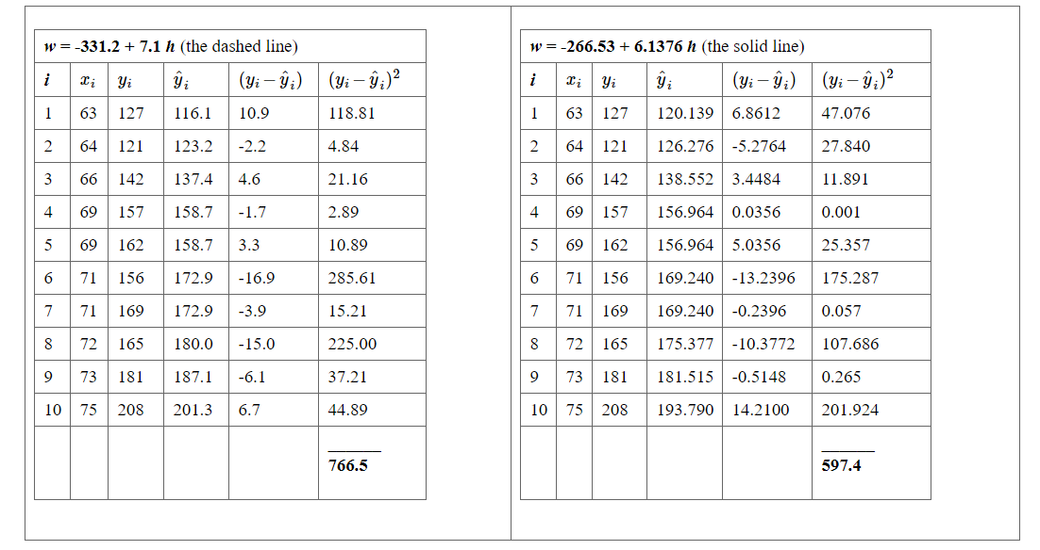
What is the "Best Fitting Line"?

Slide 51
What is the "Best Fitting Line"?
Based on the least squares criterion, which equation best summarizes the data?
The sum of the squared prediction errors is 766.5 for the dashed line, while it is only 597.4 for the solid line.
Therefore, of the two lines, the solid line, w = -266.53 + 6.1376h, best summarizes the data.

Slide 52
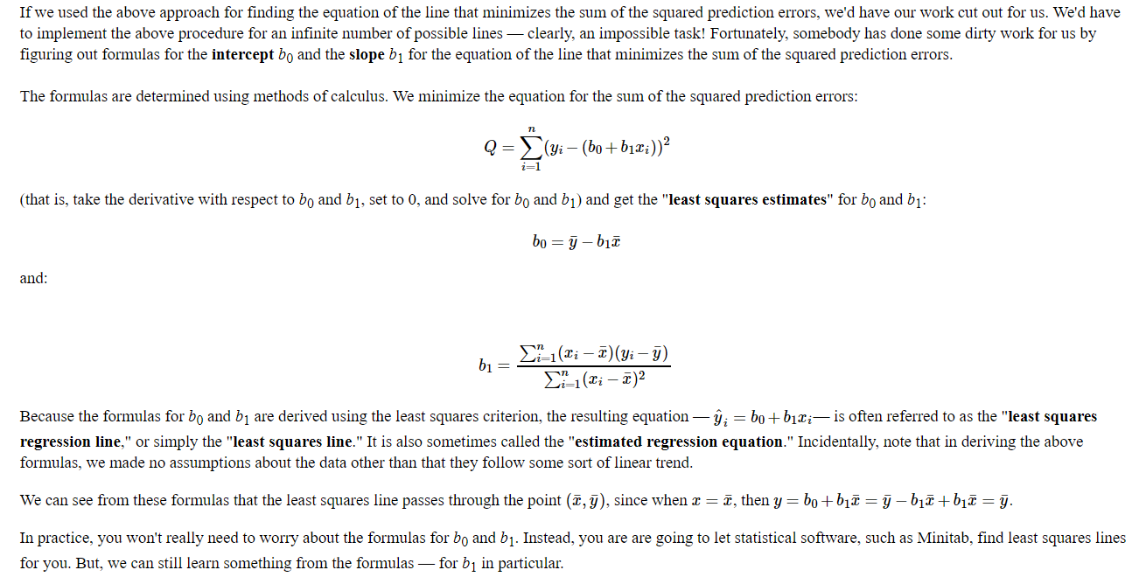
What is the "Best Fitting Line"?

Slide 53
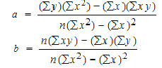
Slope and Intercept calculation

Slide 54
How to Find a Linear Regression Equation: Steps
Step 1: Make a chart of your data, filling in the columns in the same way as you would fill in the chart if you were finding the Pearson’s Correlation Coefficient.
SUBJECT | AGE X | GLUCOSE LEVEL Y | XY | X² | Y²
1 | 43 | 99 | 4257 | 1849 | 9801
2 | 21 | 65 | 1365 | 441 | 4225
3 | 25 | 79 | 1975 | 625 | 6241
4 | 42 | 75 | 3150 | 1764 | 5625
5 | 57 | 87 | 4959 | 3249 | 7569
6 | 59 | 81 | 4779 | 3481 | 6561
Σ | 247 | 486 | 20485 | 11409 | 40022
From the above table, Σx = 247, Σy = 486, Σxy = 20485, Σx2 = 11409, Σy2 = 40022. n is the sample size (6, in our case).

Slide 55
How to Find a Linear Regression Equation: Steps
Step 2: Use the following equations to find a and b.
a = 65.1416 b = .385225

Slide 56
How to Find a Linear Regression Equation: Steps
Step 2: Use the following equations to find a and b.
Find a:
((486 × 11,409) – ((247 × 20,485)) / 6 (11,409) – 247²)
484979 / 7445
=65.14
Find b:
(6(20,485) – (247 × 486)) / (6 (11409) – 247²)
(122,910 – 120,042) / 68,454 – 247²
2,868 / 7,445
= .385225

Slide 57
How to Find a Linear Regression Equation: Steps
Step 3: Insert the values into the equation. y’ = a + bx y’ = 65.14 + .385225x
That’s how to find a linear regression equation by hand!

Slide 58
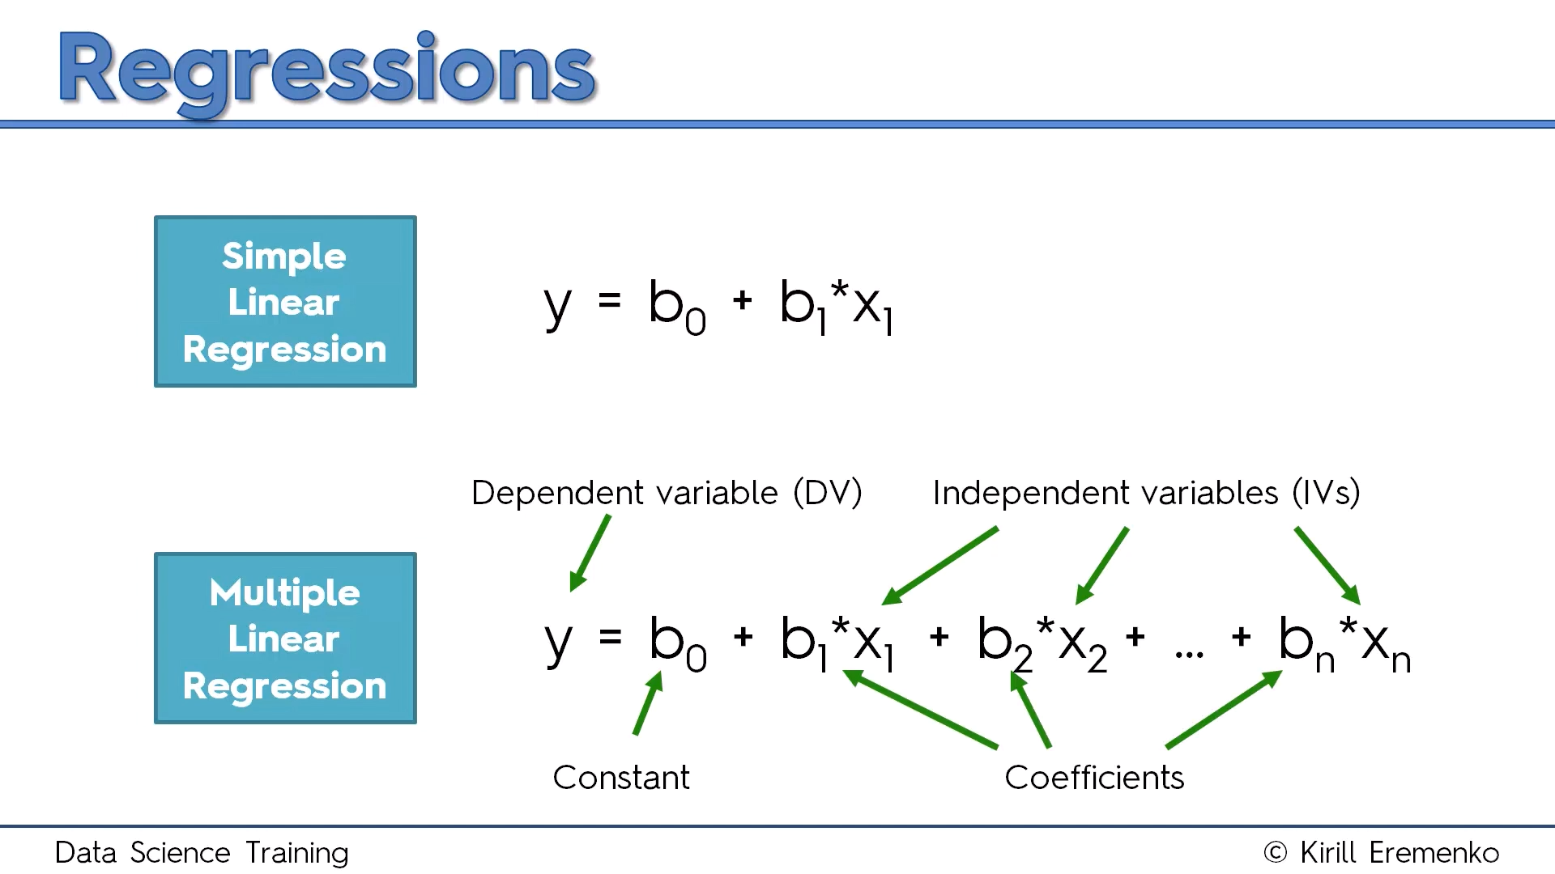
Multiple Linear Regression

Slide 59
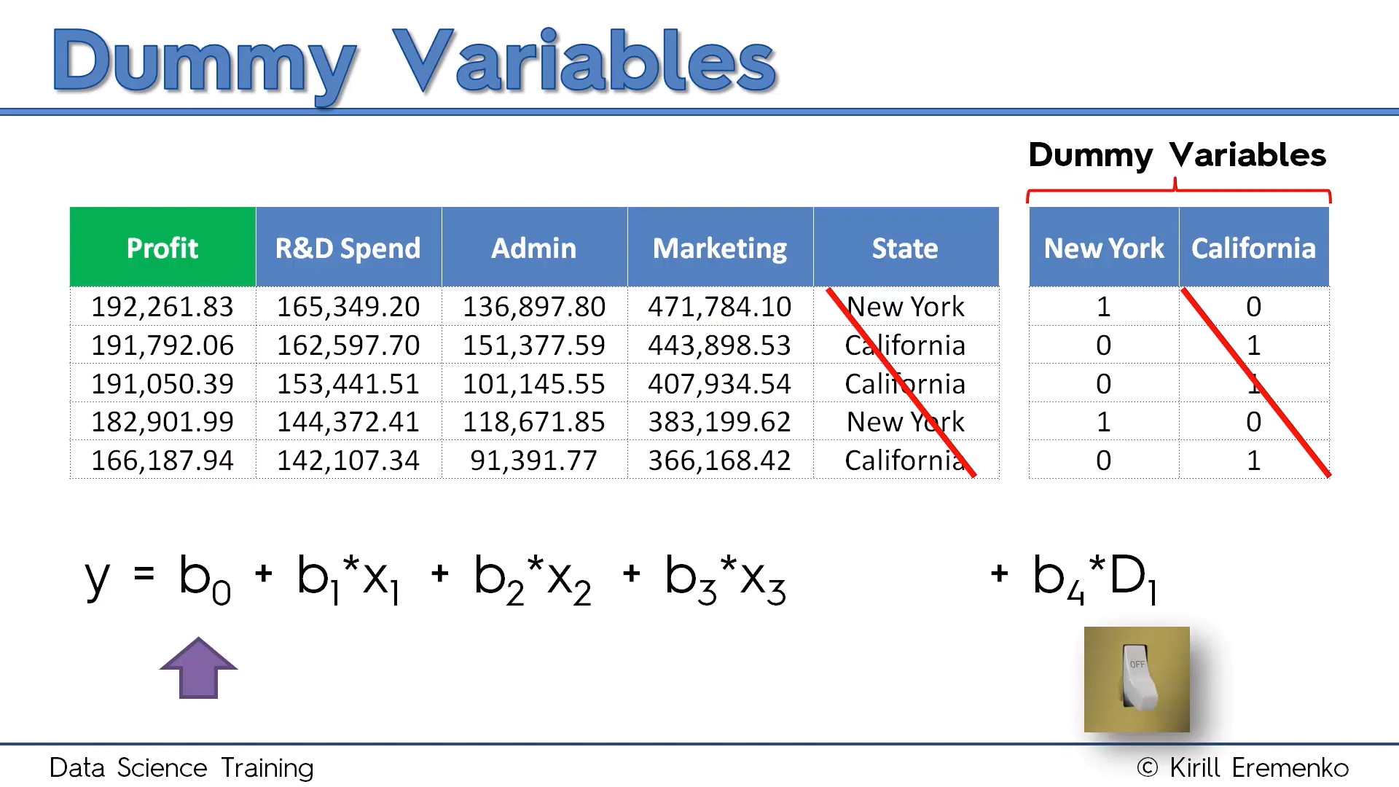

Slide 60
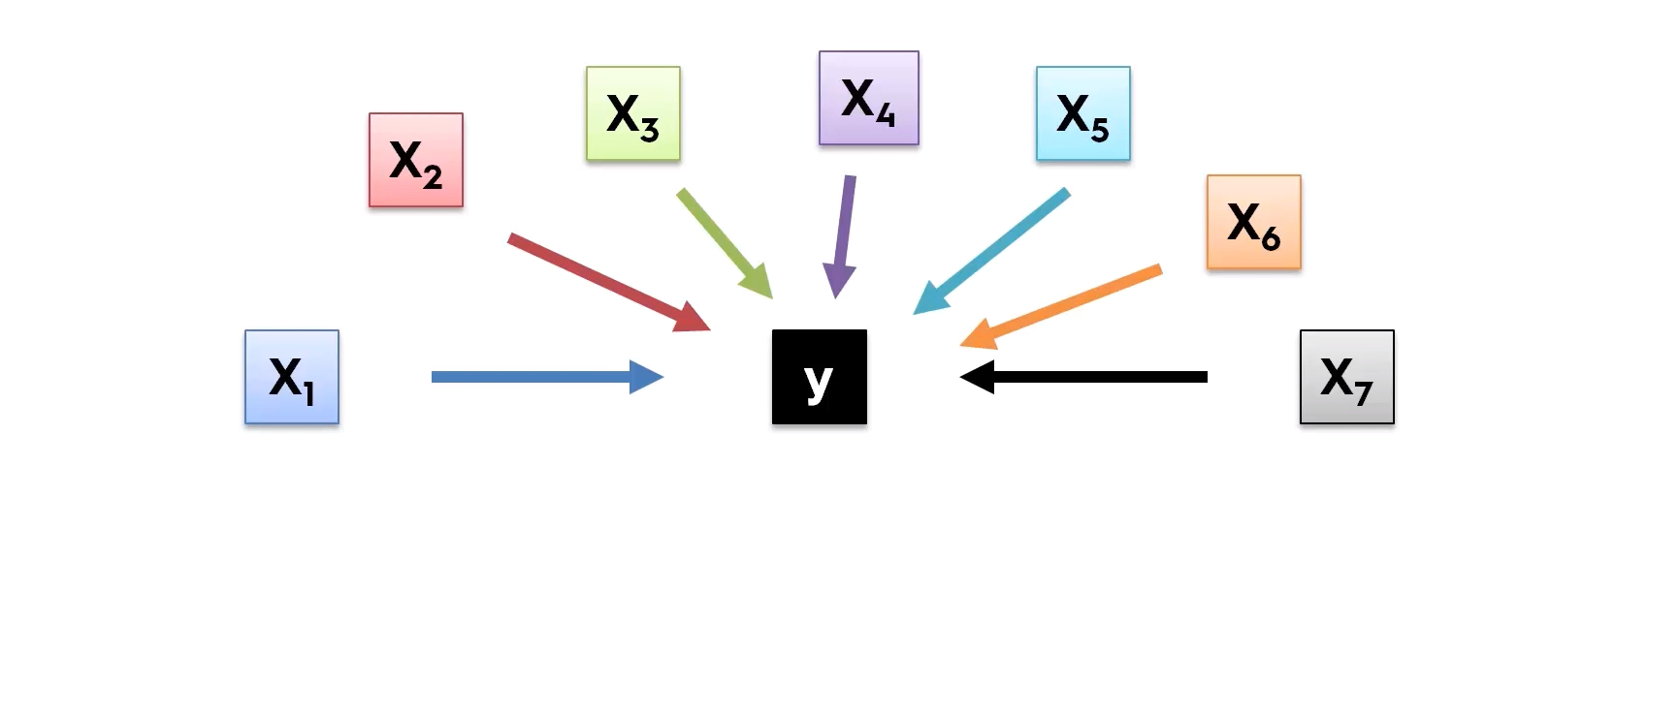
Building Model

Slide 61
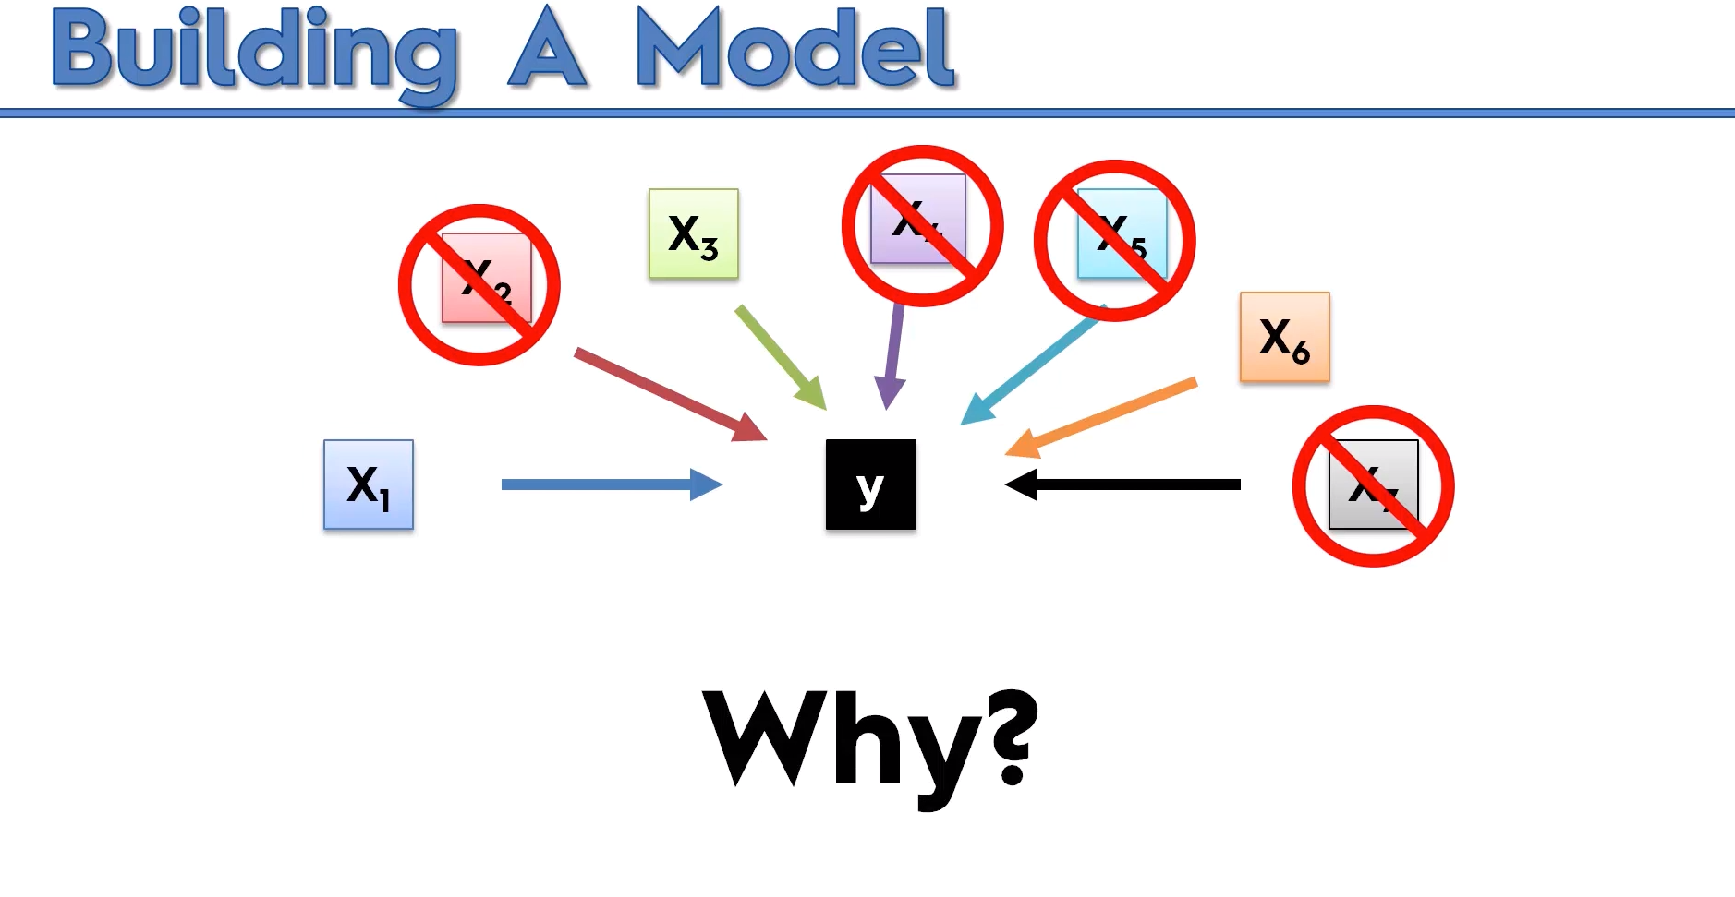

Slide 62
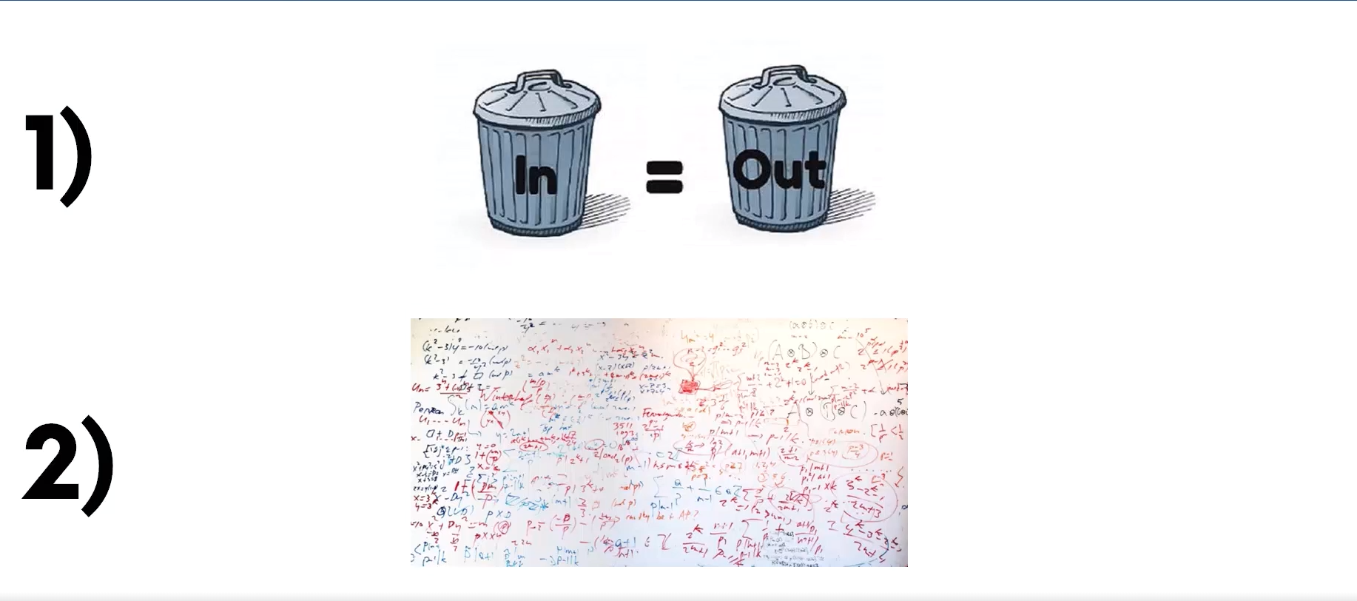

Slide 63
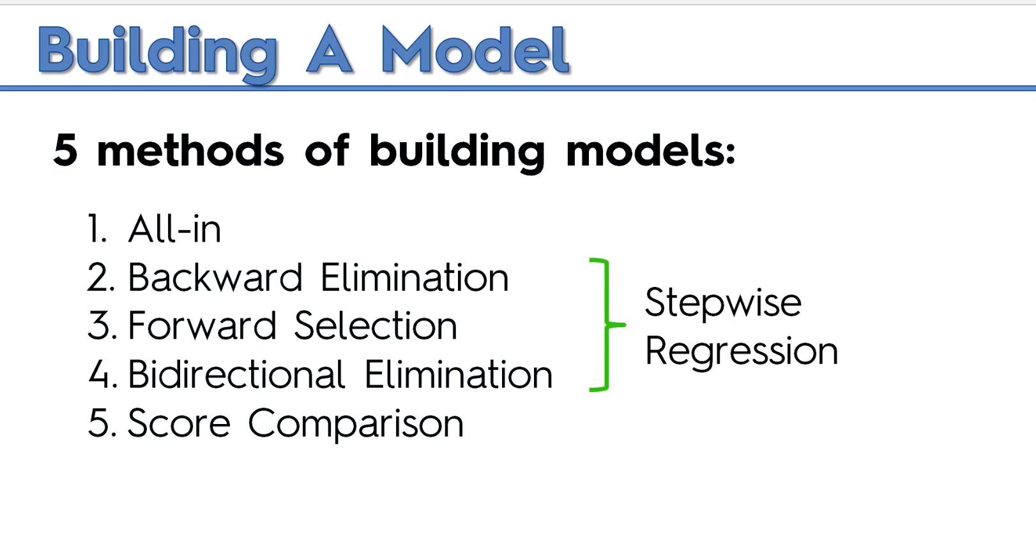

Slide 64
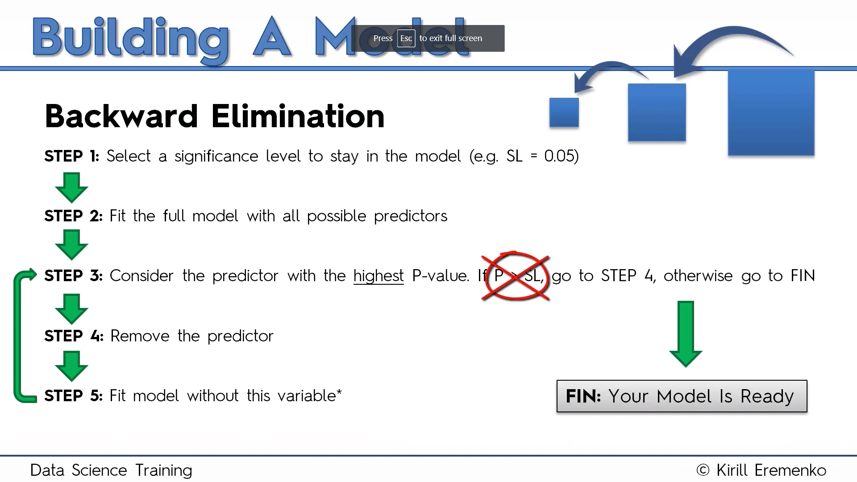

Slide 65
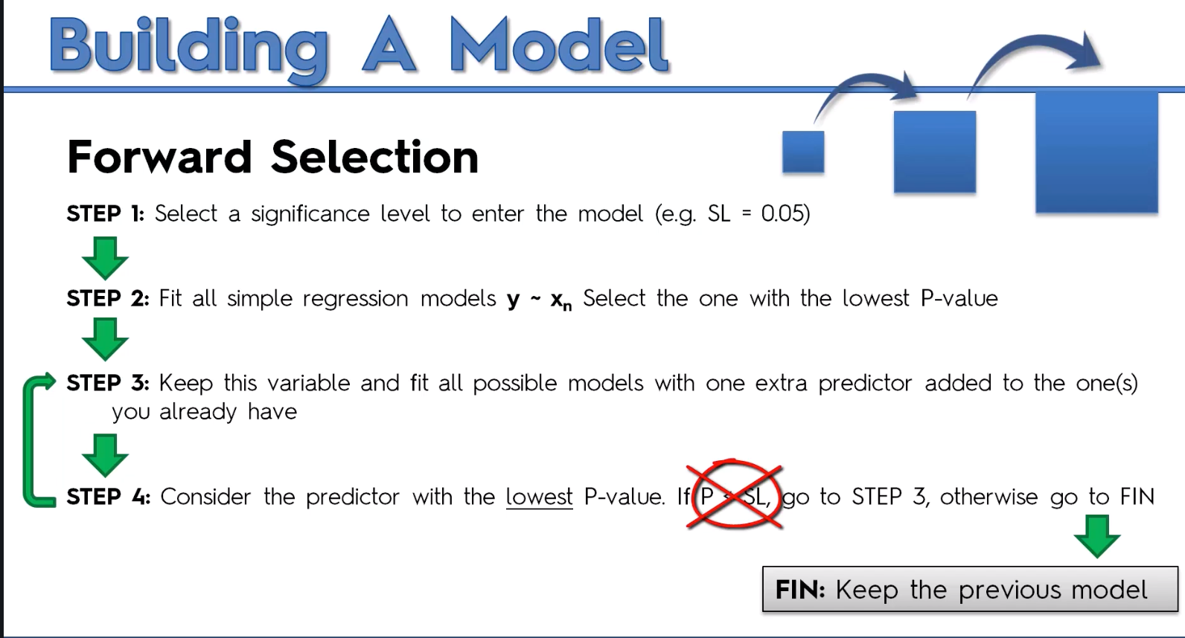

Slide 66
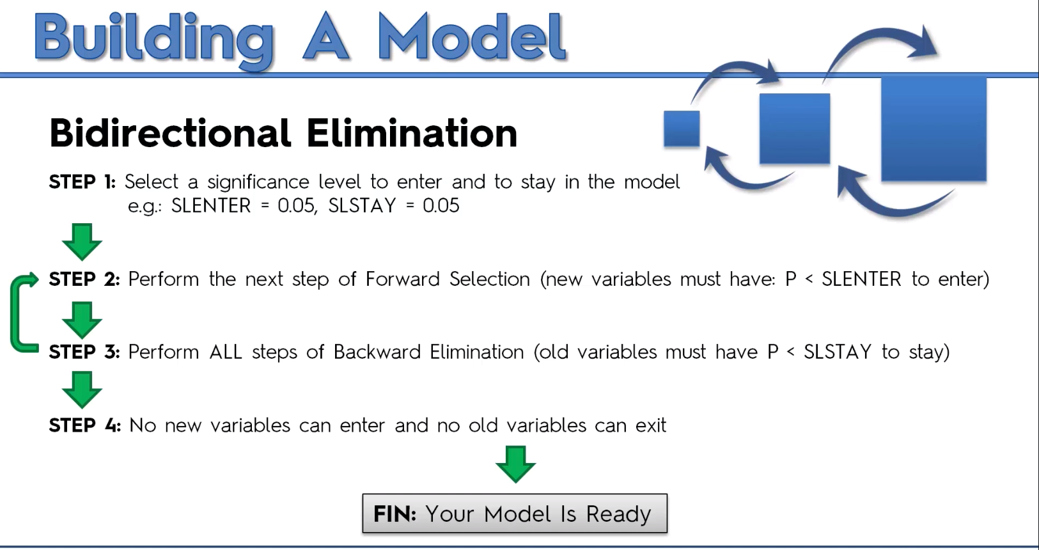

Slide 67
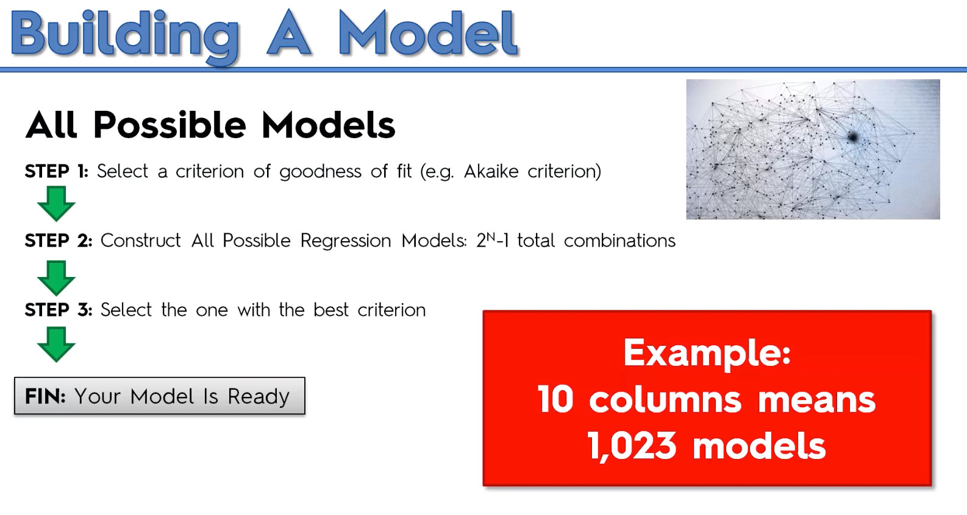

Slide 68
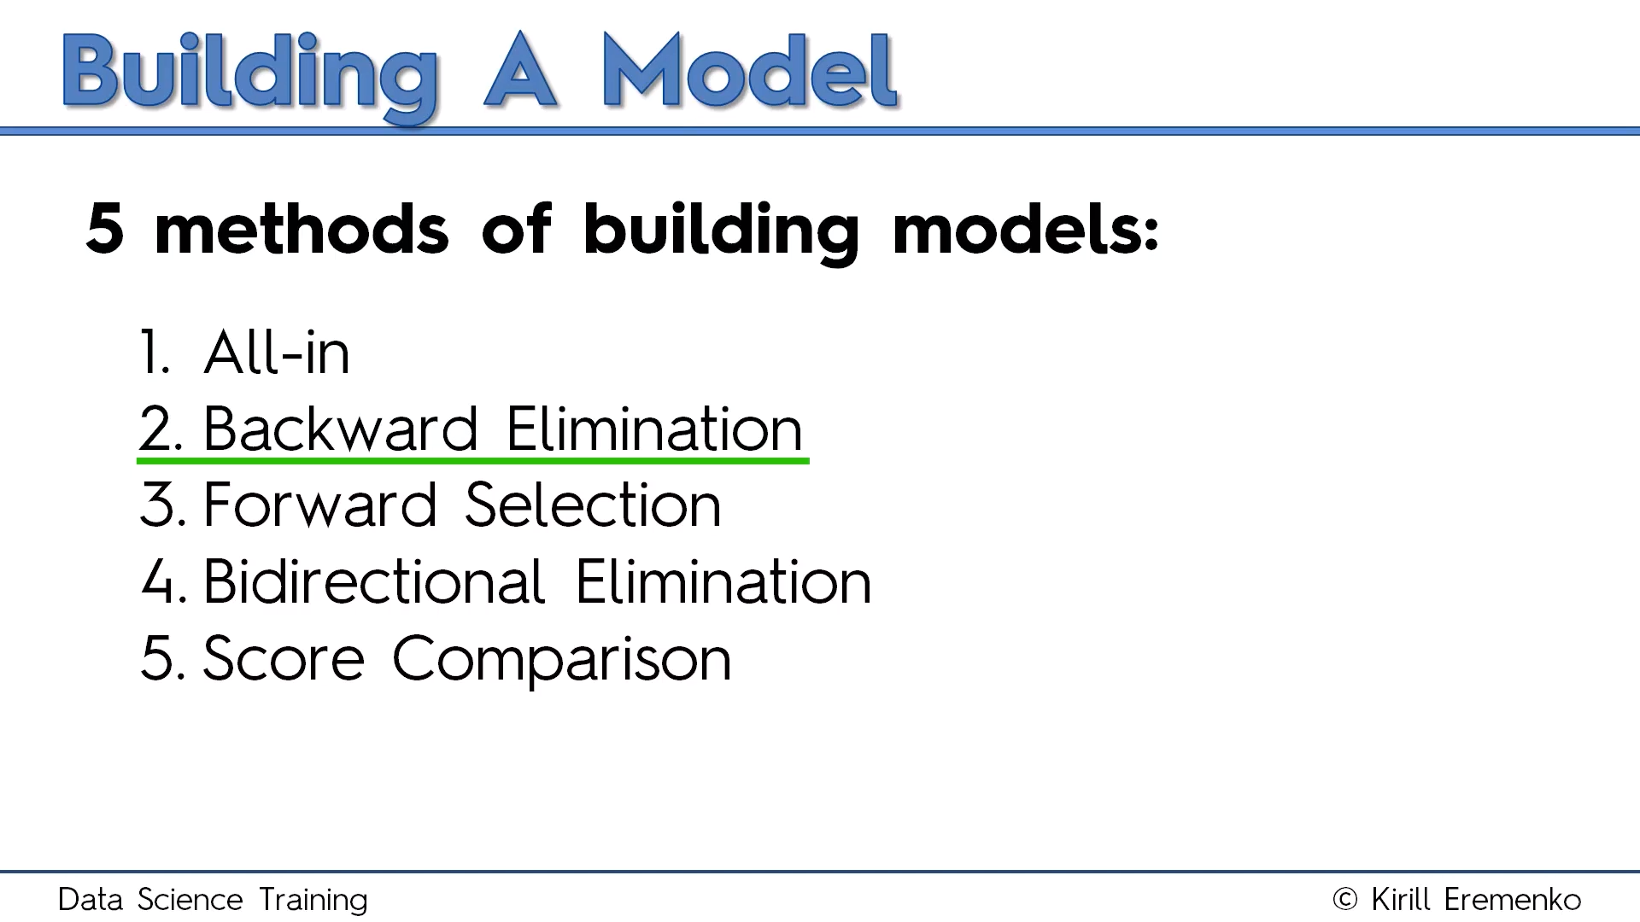

Slide 69
import statsmodels.formula.api as sm
def backwardElimination(x, sl):
numVars = len(x[0])
for i in range(0, numVars):
regressor_OLS = sm.OLS(y, x).fit()
maxVar = max(regressor_OLS.pvalues).astype(float)
if maxVar > sl:
for j in range(0, numVars - i):
if (regressor_OLS.pvalues[j].astype(float) == maxVar):
x = np.delete(x, j, 1)
regressor_OLS.summary()
return x
SL = 0.05
X_opt = X[:, [0, 1, 2, 3, 4, 5]]
X_Modeled = backwardElimination(X_opt, SL)

Slide 70
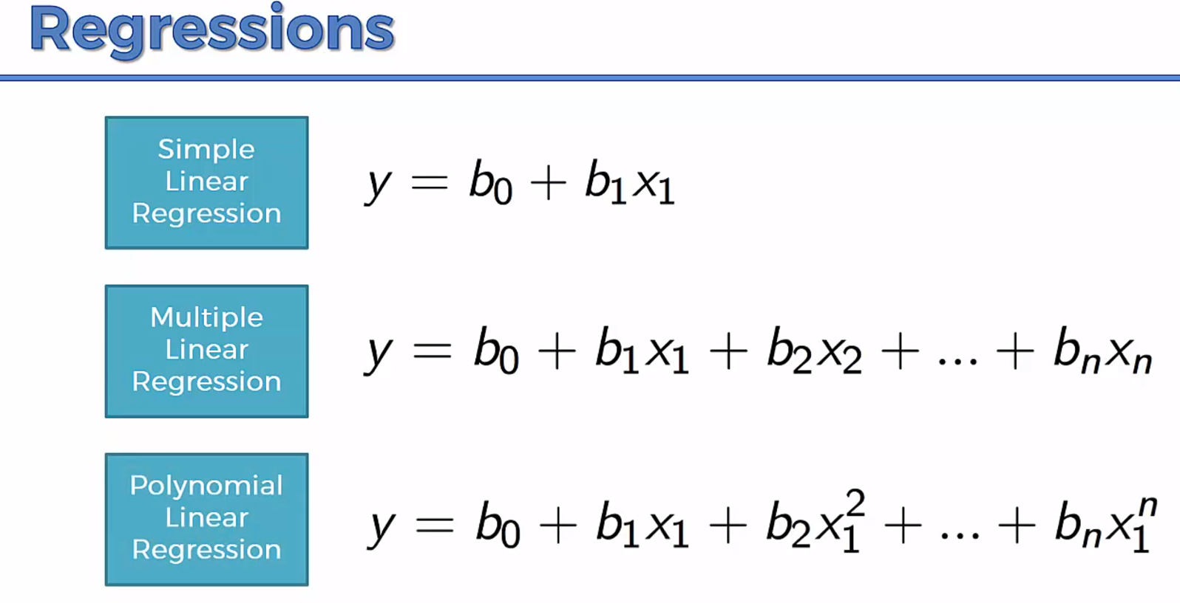

Slide 71
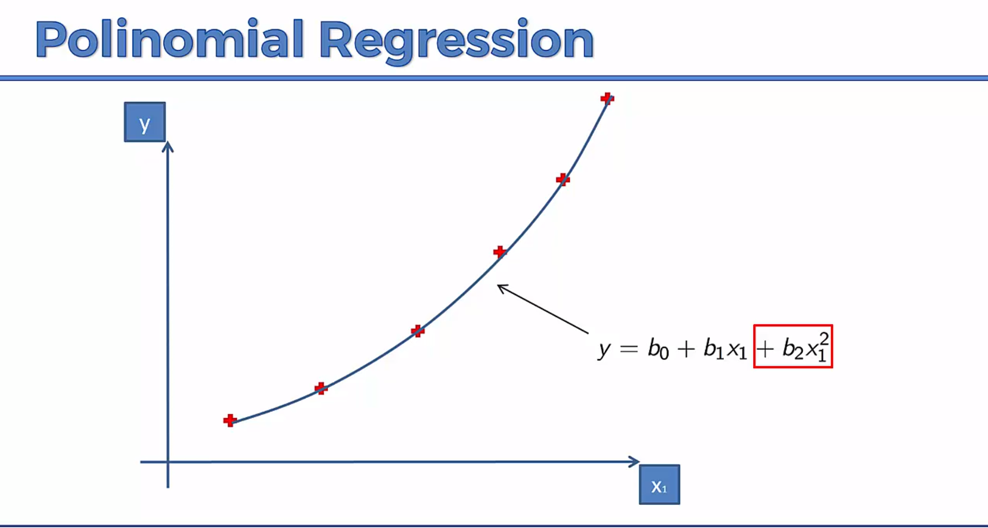

Slide 72
Support Vector Regression
SVM is a supervised learning model
Problem:
I have a business and I receive a lot of emails from customers every day. Some of these emails are complaints and should be answered very quickly. I would like a way to identify them quickly so that I answer these email in priority.

Slide 73
Support Vector Regression
Approach: I can use a supervised machine learning algorithm.
Step 1: I need a lot of emails, the more the better. Step 2: I will read the title of each email and classify it by saying "it is a complaint" or "it is not a complaint". It put a label on each email. Step 3: I will train a model on this dataset Step 4: I will assess the quality of the prediction (using cross validation) Step 5: I will use this model to predict if an email is a complaint or not.
In this case, if I have trained the model with a lot of emails then it will perform well. SVM is just one among many models you can use to learn from this data and make predictions.

Slide 74
Support Vector Regression
SVMs - Support Vector Machines
Wikipedia tells us that SVMs can be used to do two things: classification or regression.
SVM is used for classification
SVR (Support Vector Regression) is used for regression

Slide 75
What is the goal of the Support Vector Machine (SVM)?
The goal of a support vector machine is to find the optimal separating hyperplane which maximizes the margin of the training data.
The first thing we can see from this definition, is that a SVM needs training data. Which means it is a supervised learning algorithm.
It is also important to know that SVM is a classification algorithm. Which means we will use it to predict if something belongs to a particular class.

Slide 76


Slide 77
SVM
We have plotted the size and weight of several people, and there is also a way to distinguish between men and women.
With such data, using a SVM will allow us to answer the following question:
Given a particular data point (weight and size), is the person a man or a woman ?
For instance: if someone measures 175 cm and weights 80 kg, is it a man of a woman?

Slide 78

What is a separating hyperplane?
For instance, we could trace a line and then all the data points representing men will be above the line, and all the data points representing women will be below the line.
Such a line is called a separating hyperplane and is depicted below:

Slide 79
If it is just a line, why do we call it an hyperplane ?
An hyperplane is a generalization of a plane.
in one dimension, an hyperplane is called a point
in two dimensions, it is a line
in three dimensions, it is a plane
in more dimensions you can call it an hyperplane

Slide 80

What is the optimal separating hyperplane?
The fact that you can find a separating hyperplane, does not mean it is the best one !
In the example below there is several separating hyperplanes. Each of them is valid as it successfully separates our data set with men on one side and women on the other side.

Slide 81

Optimal Hyperplane
The black hyperplane classifies more accurately than the green one

Slide 82

What is the margin and how does it help choosing the optimal hyperplane?
Given a particular hyperplane, we can compute the distance between the hyperplane and the closest data point.
Once we have this value, if we double it we will get what is called the margin.
Basically the margin is a no man's land. There will never be any data point inside the margin.

Slide 83
Optimal Hyperplane
We can make the following observations:
If an hyperplane is very close to a data point, its margin will be small.
The further an hyperplane is from a data point, the larger its margin will be.
This means that the optimal hyperplane will be the one with the biggest margin.

Slide 84


What is a vector?
A vector is an object that has both a magnitude and a direction.
If we define a point A(3,4) in R2 we can plot it like this.
Definition: Any point x=(x1,x2),x≠0, in R2 specifies a vector in the plane, namely the vector starting at the origin and ending at x.
If we say that the point at the origin is the point O(0,0) then the vector above is the vector OA→. We could also give it an arbitrary name such as u.

Slide 85


The magnitude
The magnitude or length of a vector x is written ∥x∥ and is called its norm.
For our vector OA→, ∥OA∥ is the length of the segment OA

Slide 86

The direction
The direction is the second component of a vector.
Definition : The direction of a vector u(u1,u2) is the vector w(u1∥u∥,u2∥u∥)

Slide 87


Computing the direction vector
The direction of u(3,4) is the vector w(0.6,0.8)

Slide 88

The sum of two vectors

Slide 89

Third Vector

Slide 90

The difference between two vectors

Slide 91

The difference between two vectors

Slide 92

The dot product
Definition: Geometrically, it is the product of the Euclidian magnitudes of the two vectors and the cosine of the angle between them

Slide 93

We can see that
θ=β−α
So computing cos(θ) is like computing cos(β−α)
There is a special formula called the difference identity for cosine which says that:
cos(β−α)=cos(β)cos(α)+sin(β)sin(α)

Slide 94


Slide 95


Slide 96

The SVM hyperplane
Understanding the equation of the hyperplane
You probably learnt that an equation of a line is : y=ax+b. However when reading about hyperplane, you will often find that the equation of an hyperplane is defined by :

Slide 97
The SVM hyperplane
How does these two forms relate ?
In the hyperplane equation you can see that the name of the variables are in bold. Which means that they are vectors !
Moreover, wTx is how we compute the inner product of two vectors, and if you recall, the inner product is just another name for the dot product !

Slide 98

The SVM hyperplane

Slide 99

The SVM hyperplane
For two reasons:
it is easier to work in more than two dimensions with this notation,
the vector w will always be normal to the hyperplane.

Slide 100
SVM hyperplane
Our goal is to find the distance between the point A(3,4) and the hyperplane.
We start with two vectors, w=(2,1) which is normal to the hyperplane, and a=(3,4) which is the vector between the origin and A.

Slide 101


Slide 102

SVM Hyperplane
Compute the margin of the hyperplane
Now that we have the distance ∥p∥ between A and the hyperplane, the margin is defined by :

Slide 103

Optimal hyperplane

Slide 104
α
Maximum Margin
x
f
y^{est}
Maximizing the margin is good according to intuition and PAC theory
Implies that only support vectors are important; other training examples are ignorable.
Empirically it works very very well.
f(x,w,b) = sign(w x + b)
denotes +1
denotes -1
The maximum margin linear classifier is the linear classifier with the, um, maximum margin.
This is the simplest kind of SVM (Called an LSVM)
Support Vectors are those datapoints that the margin pushes up against
Linear SVM

Slide 105
Linear SVM Mathematically
x⁺
M=Margin Width
“Predict Class = +1” zone
X⁻
wx+b=1
“Predict Class = -1” zone
wx+b=0
wx+b=-1
What we know:
w . x⁺ + b = +1
w . x⁻ + b = -1
w . (x⁺-x⁻⁾ = 2

Slide 106
Linear SVM Mathematically
Goal: 1) Correctly classify all training data
if y_{i} = +1
if y_{i} = -1
for all i
2) Maximize the Margin
same as minimize
We can formulate a Quadratic Optimization Problem and solve for w and b
Minimize
subject to

Slide 107
Solving the Optimization Problem
Find w and b such that
Φ(w) =½ w^{T}w is minimized;
and for all {(x_{i} ,y_{i})}: y_{i} (w^{T}x_{i} + b) ≥ 1
Need to optimize a quadratic function subject to linear constraints.
Quadratic optimization problems are a well-known class of mathematical programming problems, and many (rather intricate) algorithms exist for solving them.
The solution involves constructing a dual problem where a Lagrange multiplier α_{i} is associated with every constraint in the primary problem:
Find α₁…α_{N} such that
Q(α) =Σα_{i} - ½ΣΣα_{i}α_{j}y_{i}y_{j}x_{i}^{T}x_{j} is maximized and
(1) Σα_{i}y_{i} = 0
(2) α_{i} ≥ 0 for all α_{i}

Slide 108
The Optimization Problem Solution
The solution has the form:
Each non-zero α_{i} indicates that corresponding x_{i} is a support vector.
Then the classifying function will have the form:
Notice that it relies on an inner product between the test point x and the support vectors x_{i} – we will return to this later.
Also keep in mind that solving the optimization problem involved computing the inner products x_{i}^{T}x_{j} between all pairs of training points.
w =Σα_{i}y_{i}x_{i} b= y_{k}- w^{T}x_{k} for any x_{k} such that α_{k}≠ 0
f(x) = Σα_{i}y_{i}x_{i}^{T}x + b

Slide 109
Dataset with noise
denotes +1
denotes -1
Hard Margin: So far we require all data points be classified correctly
- No training error
What if the training set is noisy?
- Solution 1: use very powerful kernels
OVERFITTING!

Slide 110
Soft Margin Classification
Slack variables ξi can be added to allow misclassification of difficult or noisy examples.
What should our quadratic optimization criterion be?
Minimize
ε₁₁
ε₂
wx+b=1
ε₇
wx+b=0
wx+b=-1

Slide 111
Hard Margin v.s. Soft Margin
The old formulation:
The new formulation incorporating slack variables:
Parameter C can be viewed as a way to control overfitting.
Find w and b such that
Φ(w) =½ w^{T}w is minimized and for all {(x_{i} ,y_{i})}
y_{i} (w^{T}x_{i} + b) ≥ 1
Find w and b such that
Φ(w) =½ w^{T}w + CΣξ_{i} is minimized and for all {(x_{i} ,y_{i})}
y_{i} (w^{T}x_{i} + b) ≥ 1- ξ_{i} and ξ_{i} ≥ 0 for all i

Slide 112
Linear SVMs: Overview
The classifier is a separating hyperplane.
Most “important” training points are support vectors; they define the hyperplane.
Quadratic optimization algorithms can identify which training points x_{i} are support vectors with non-zero Lagrangian multipliers α_{i}.
Both in the dual formulation of the problem and in the solution training points appear only inside dot products:
Find α₁…α_{N} such that
Q(α) =Σα_{i} - ½ΣΣα_{i}α_{j}y_{i}y_{j}x_{i}^{T}x_{j} is maximized and
(1) Σα_{i}y_{i} = 0
(2) 0 ≤ α_{i} ≤ C for all α_{i}
f(x) = Σα_{i}y_{i}x_{i}^{T}x + b

Slide 113
Non-linear SVMs
Datasets that are linearly separable with some noise work out great:
But what are we going to do if the dataset is just too hard?
How about… mapping data to a higher-dimensional space:
0
x
0
x
x²
0
x

Slide 114
Non-linear SVMs: Feature spaces
General idea: the original input space can always be mapped to some higher-dimensional feature space where the training set is separable:
Φ: x → φ(x)

Slide 115
The “Kernel Trick”
The linear classifier relies on dot product between vectors K(x_{i},x_{j})=x_{i}^{T}x_{j}
If every data point is mapped into high-dimensional space via some transformation Φ: x → φ(x), the dot product becomes:
K(x_{i},x_{j})= φ(x_{i}) ^{T}φ(x_{j})
A kernel function is some function that corresponds to an inner product in some expanded feature space.
Example:
2-dimensional vectors x=[x₁ x₂]; let K(x_{i},x_{j})=(1 + x_{i}^{T}x_{j})²,
Need to show that K(x_{i},x_{j})= φ(x_{i}) ^{T}φ(x_{j}):
K(x_{i},x_{j})=(1 + x_{i}^{T}x_{j})²,
= 1+ x_{i1}²x_{j1}² + 2 x_{i1}x_{j1} x_{i2}x_{j2}+ x_{i2}²x_{j2}² + 2x_{i1}x_{j1} + 2x_{i2}x_{j2}
= [1 x_{i1}² √2 x_{i1}x_{i2} x_{i2}² √2x_{i1} √2x_{i2}]^{T} [1 x_{j1}² √2 x_{j1}x_{j2} x_{j2}² √2x_{j1} √2x_{j2}]
= φ(x_{i}) ^{T}φ(x_{j}), where φ(x) = [1 x₁² √2 x₁x₂ x₂² √2x₁ √2x₂]

Slide 116
What Functions are Kernels?
For some functions K(x_{i},x_{j}) checking that
K(x_{i},x_{j})= φ(x_{i}) ^{T}φ(x_{j}) can be cumbersome.
Mercer’s theorem:
Every semi-positive definite symmetric function is a kernel
Semi-positive definite symmetric functions correspond to a semi-positive definite symmetric Gram matrix:
K(x₁,x₁) | K(x₁,x₂) | K(x₁,x₃) | … | K(x₁,x_{N})
K(x₂,x₁) | K(x₂,x₂) | K(x₂,x₃) |  | K(x₂,x_{N})
… | … | … | … | …
K(x_{N},x₁) | K(x_{N},x₂) | K(x_{N},x₃) | … | K(x_{N},x_{N})
K=

Slide 117
Examples of Kernel Functions
Linear: K(x_{i},x_{j})= x_{i} ^{T}x_{j}
Polynomial of power p: K(x_{i},x_{j})= (1+ x_{i} ^{T}x_{j})^{p}
Gaussian (radial-basis function network):
Sigmoid: K(x_{i},x_{j})= tanh(β₀x_{i} ^{T}x_{j} + β₁)

Slide 118
Non-linear SVMs Mathematically
Dual problem formulation:
The solution is:
Optimization techniques for finding α_{i}’s remain the same!
Find α₁…α_{N} such that
Q(α) =Σα_{i} - ½ΣΣα_{i}α_{j}y_{i}y_{j}K(x_{i}, x_{j}) is maximized and
(1) Σα_{i}y_{i} = 0
(2) α_{i} ≥ 0 for all α_{i}
f(x) = Σα_{i}y_{i}K(x_{i}, x_{j})+ b

Slide 119
Nonlinear SVM - Overview
SVM locates a separating hyperplane in the feature space and classify points in that space
It does not need to represent the space explicitly, simply by defining a kernel function
The kernel function plays the role of the dot product in the feature space.

Slide 120
Properties of SVM
Flexibility in choosing a similarity function
Sparseness of solution when dealing with large data sets
- only support vectors are used to specify the separating hyperplane
Ability to handle large feature spaces
- complexity does not depend on the dimensionality of the feature space
Overfitting can be controlled by soft margin approach
Nice math property: a simple convex optimization problem which is guaranteed to converge to a single global solution
Feature Selection

Slide 121
SVM Applications
SVM has been used successfully in many real-world problems
- text (and hypertext) categorization
- image classification
- bioinformatics (Protein classification,
Cancer classification)
- hand-written character recognition

Slide 122
Application 1: Cancer Classification
High Dimensional
- p>1000; n<100
Imbalanced
- less positive samples
Many irrelevant features
Noisy
Genes
Patients | g-1 | g-2 | …… | g-p
P-1
p-2
…….
p-n
FEATURE SELECTION
In the linear case,
w_{i}² gives the ranking of dim i
SVM is sensitive to noisy (mis-labeled) data ☹

Slide 123
Weakness of SVM
It is sensitive to noise
- A relatively small number of mislabeled examples can dramatically decrease the performance
It only considers two classes
- how to do multi-class classification with SVM?
- Answer:
1) with output arity m, learn m SVM’s
SVM 1 learns “Output==1” vs “Output != 1”
SVM 2 learns “Output==2” vs “Output != 2”
:
SVM m learns “Output==m” vs “Output != m”
2)To predict the output for a new input, just predict with each SVM and find out which one puts the prediction the furthest into the positive region.

Slide 124
Application 2: Text Categorization
Task: The classification of natural text (or hypertext) documents into a fixed number of predefined categories based on their content.
- email filtering, web searching, sorting documents by topic, etc..
A document can be assigned to more than one category, so this can be viewed as a series of binary classification problems, one for each category

Slide 125

Representation of Text
IR’s vector space model (aka bag-of-words representation)
A doc is represented by a vector indexed by a pre-fixed set or dictionary of terms
Values of an entry can be binary or weights
Normalization, stop words, word stems
Doc x => φ(x)

Slide 126
Text Categorization using SVM
The distance between two documents is φ(x)·φ(z)
K(x,z) = 〈φ(x)·φ(z) is a valid kernel, SVM can be used with K(x,z) for discrimination.
Why SVM?
-High dimensional input space
-Few irrelevant features (dense concept)
-Sparse document vectors (sparse instances)
-Text categorization problems are linearly separable

Slide 127
Some Issues
Choice of kernel
- Gaussian or polynomial kernel is default
- if ineffective, more elaborate kernels are needed
- domain experts can give assistance in formulating appropriate similarity measures
Choice of kernel parameters
- e.g. σ in Gaussian kernel
- σ is the distance between closest points with different classifications
- In the absence of reliable criteria, applications rely on the use of a validation set or cross-validation to set such parameters.
Optimization criterion – Hard margin v.s. Soft margin
- a lengthy series of experiments in which various parameters are tested

Slide 128
Decision Tree Regression
Decision tree builds regression or classification models in the form of a tree structure.
It brakes down a dataset into smaller and smaller subsets while at the same time an associated decision tree is incrementally developed.
The final result is a tree with decision nodes and leaf nodes.
A decision node (e.g., Outlook) has two or more branches (e.g., Sunny, Overcast and Rainy), each representing values for the attribute tested.
Leaf node (e.g., Hours Played) represents a decision on the numerical target.
The topmost decision node in a tree which corresponds to the best predictor called root node.
Decision trees can handle both categorical and numerical data.

Slide 129

Decision Tree Regression

Slide 130
Decision Tree Regression
The core algorithm for building decision trees called ID3 by J. R. Quinlan which employs a top-down, greedy search through the space of possible branches with no backtracking.
The ID3 algorithm can be used to construct a decision tree for regression by replacing Information Gain with Standard Deviation Reduction.

Slide 131

Decision Tree Regression

Slide 132

Decision Tree Regression

Slide 133
Decision Tree Regression
1.compute the entropy for data-set
2.for every attribute/feature:
1.calculate entropy for all categorical values
2.take average information entropy for the current attribute
3.calculate gain for the current attribute
3. pick the highest gain attribute.
4. Repeat until we get the tree we desired.

Slide 134

Decision Tree Regression Compute the entropy for the weather data set:

Slide 135

Decision Tree Regression For every feature calculate the entropy and information gain

Slide 136

Pick the highest gain attribute.

Slide 137

So our root node is Outlook.

Slide 138

Repeat the same thing for sub-trees till we get the tree.

Slide 139

Final Decision Tree

Slide 140
Logistic Regression
Logistic regression predicts the probability of an outcome that can only have two values (i.e. a dichotomy).
The prediction is based on the use of one or several predictors (numerical and categorical).
A linear regression is not appropriate for predicting the value of a binary variable for two reasons:
A linear regression will predict values outside the acceptable range (e.g. predicting probabilities outside the range 0 to 1)
Since the dichotomous experiments can only have one of two possible values for each experiment, the residuals will not be normally distributed about the predicted line.

Slide 141
Logistic Regression
On the other hand, a logistic regression produces a logistic curve, which is limited to values between 0 and 1.
Logistic regression is similar to a linear regression, but the curve is constructed using the natural logarithm of the “odds” of the target variable, rather than the probability.
Moreover, the predictors do not have to be normally distributed or have equal variance in each group.

Slide 142
Example
Example 1: Suppose that we are interested in the factors that influence whether a political candidate wins an election.
The outcome (response) variable is binary (0/1); win or lose.
The predictor variables of interest are the amount of money spent on the campaign, the amount of time spent campaigning negatively and whether or not the candidate is an incumbent.
Example 2: A researcher is interested in how variables, such as GRE (Graduate Record Exam scores), GPA (grade point average) and prestige of the undergraduate institution, effect admission into graduate school. The response variable, admit/don’t admit, is a binary variable.

Slide 143

Logistic Regression

Slide 144

Logistic Regression
In the logistic regression the constant (b0) moves the curve left and right and the slope (b1) defines the steepness of the curve. By simple transformation, the logistic regression equation can be written in terms of an odds ratio.

Slide 145

Logistic Regression
Finally, taking the natural log of both sides, we can write the equation in terms of log-odds (logit) which is a linear function of the predictors. The coefficient (b₁) is the amount the logit (log-odds) changes with a one unit change in x.

Slide 146


Logistic Regression
As mentioned before, logistic regression can handle any number of numerical and/or categorical variables.

